Slide 1
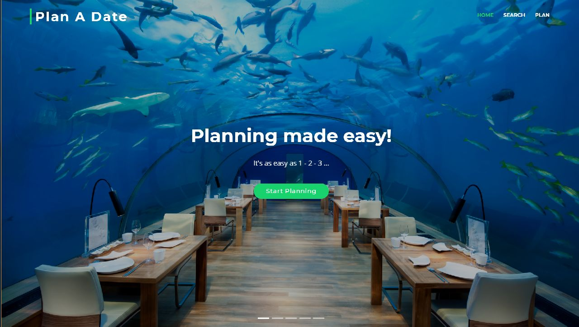
The Dragon’s Den Team
Plan A Date
Alton Salmon
Vicki Hope
Jamie Rodriguez
Daniel Valverde

Slide 2
Plan a Date
CONCEPT:
- Provide a centralized location for selecting food, activities, and events
- For a user-specified date, time and location (i.e. the 'KAYAK' of event planning)
MOTIVATION:
to simplify the planning process by:
- having options in one place
to save time, increase efficiency by:
- limiting options based on user’s date and location

Slide 3
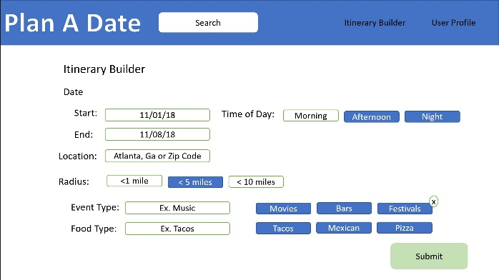
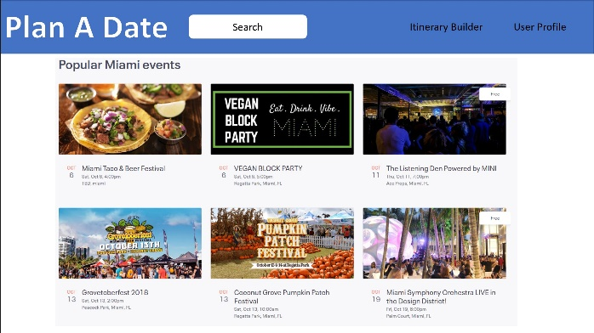
Design Process
Examples from wireframe
How we started:
1
As a group we brainstormed ideas until we agreed on one idea.
We used the README.md file to list project requirements and pseudocode minimum viable product in a central location.
2
3
We started with a wireframe diagram to layout the basic visual design so we could agree on flow and visualize the parts to be created.
4
We split the project into sections:
Wire frame (Daniel, with input from all)
project organization (Vicki, with input from all)
code keeper (Alton)
main JavaScript (Alton, with input from all)
HTML/CSS (Jamie (Search page), Vicki (carousel), (Daniel)
API 1 (SeatGeek – Jamie)
API 2 (Yelp – Vicki)
additional requirements (add-on JavaScript libraries) EVERYONE.
Presentation (Daniel)

Slide 4
Design Process (continued)
How we progressed:
5
We did not assign hard due dates. We shared our progress during each class then agreed on tasks due by the next class.
6
We all struggled with GIT! However, when we ran into issues, we worked as a team, shared our screen and walked through the issues with each other.
7
Responsive Design

Slide 5
Technologies Used
jQuery
Bootstrap
HTML
CSS
JavaScript
Yelp API
SeatGeek API
Additional jQuery, JavaScript, CSS Libraries used in project
Superfish (javascript)
Lightbox (javascript)
Easing
WOW
Isotope
Touchswipe (jquery plugin)
Font-Awesome (css)
ion-icon (css)

Slide 6
Future Development
Extendibility
Add areas for advertisers
link to Open Table to make reservations
link to Fandango to purchase movie tickets
link to StubHub/Ticketmaster to purchase tickets
add user budget information to narrow event detail
add transportation options (bus, taxi, uber)
add hotel options, link to reservation information
add services like sending flowers after the date
Accessibility
add speech to text (annyang)
add support for multiple languages
Shareability
send plan via email to user (and guests if desired)
add “save to favorites” option (within event type)
save the planned event on the website so others people have access
alternatively, save the event plan on user's calendar (phone or computer)

Slide 7
Plan A Date Demonstration

Slide 8
Thank You!
QUESTIONS?
Notes:
In Slide Show mode, select the arrows to visit links.

